Slide 1
SHRAVYA GUNNALA
EMPLOYEE ID: 152982
JAVA FULL STACK, MIPL

Slide 2
CapStore Shopping Application

Slide 3
Project Requirements

Slide 4
Softwares:
Java 10
STS Version: 3.9.4.RELEASE
Bootstrap
MySQL 5.5 Command Line Client
HTML 5
CSS 3
JavaScript
JSP
Spring Boot (2.0.4)
Spring Rest
Notes:
Fixar a posicao do titulo – sempre do lado esquerdo.
Sempre que tiver muito texto o coluna deve sempre ser “ narrowed” , se nao fica dificil de ler. Colocar paragrafos no texto.
Linha vertical deve ser mais fina e as pontas NUNCA devem ser arredondadas.

Slide 5
MODULE
DELIVERING PRODUCTS

Slide 6
Delivering Products
Admin will check and update the delivery status.
If delivery status is “UnDelivered” then the Inventory quantity(stock) is updated.
If delivery status is “Delivered” then the Delivered date will be updated in Order table.

Slide 7
Tables Used
Inventory
productId
category
dateOfInclusion
description
expiryDate
noOfViews
Price
productName
quantity
brandId
couponId
discountId
invoiceProductId
merchantId
ManagingCart
cartId
quantity
status
customerId
productId
orderId
Order
orderId
deliveredDate
deliveryStatus
orderDate
customer

Slide 8
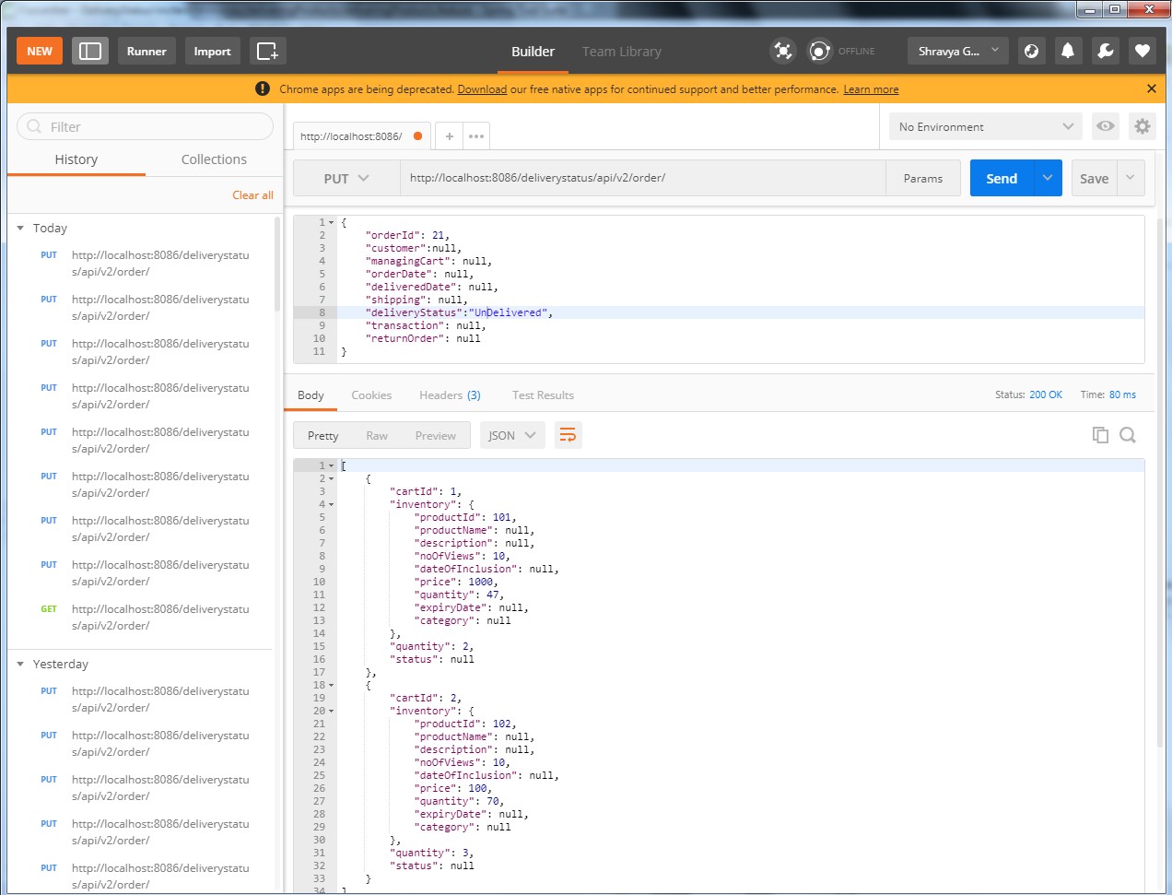

Slide 9
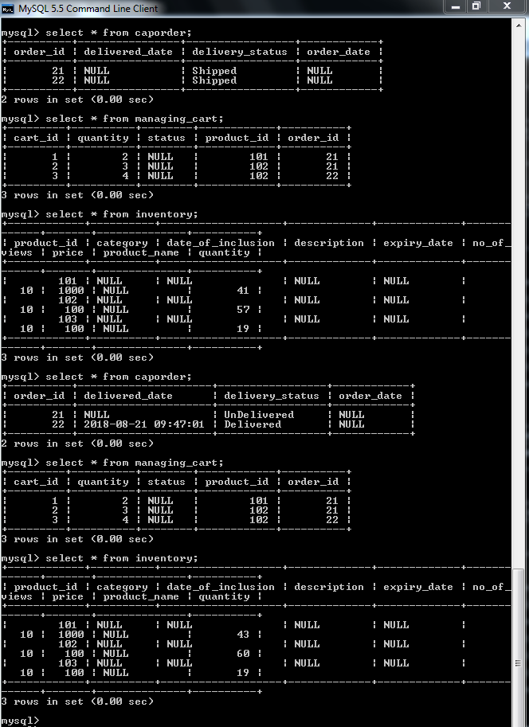

Slide 10
Thank You
Notes:
O Box atras do texto desnecessario. Deixar o layout mais simples.

